Slide 1
SQL Function
Use built-in Function

Slide 2
SQL FUNCTIONS USAGE
Kalkulasi data
Modifikasi attribute
Formatting
Konversi tipe data

Slide 3
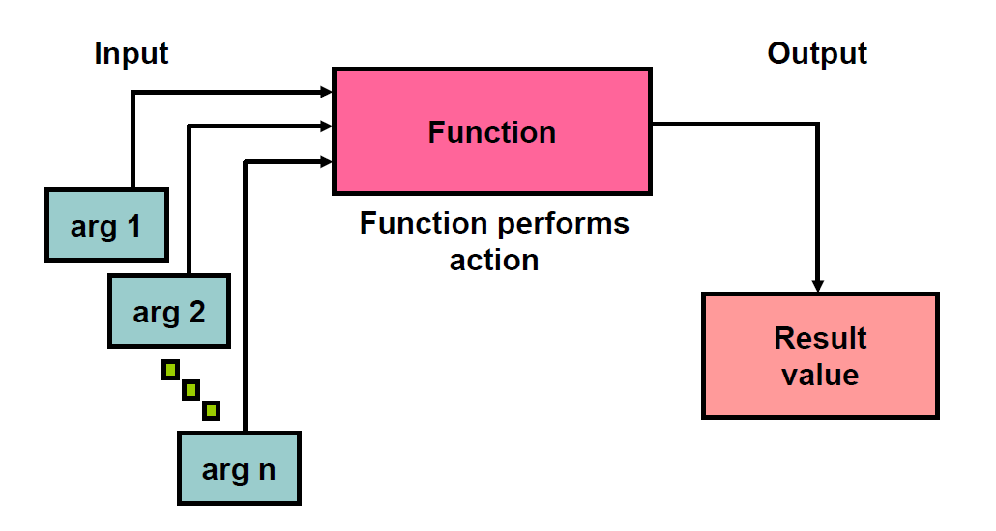
SQL FUNCTIONS
Setiap function, membutuhkan syntax dan argument yang berbeda-beda:

Slide 4
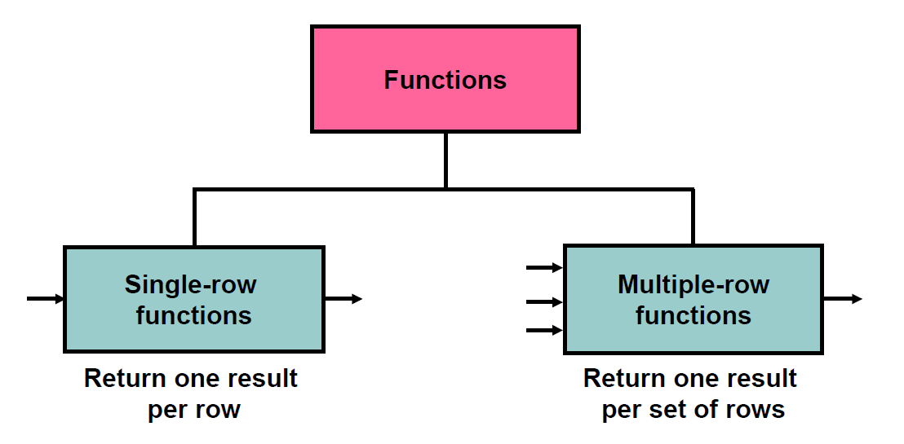
SQL FUNCTIONS
Functions terdiri dari dua tipe

Slide 5
SINGLE ROW FUNCTION

Slide 6
SINGLE ROW FUNCTIONS
Manipulasi data
Input berupa argument dan menghasilkan SATU output
Bekerja di setiap row data dan menghasilkan satu ouput pada setiap row
Dapat digunakan bersama-sama/bertingkat (nested)
Dapat digunakan pada SELECT, WHERE, dan ORDER BY

Slide 7
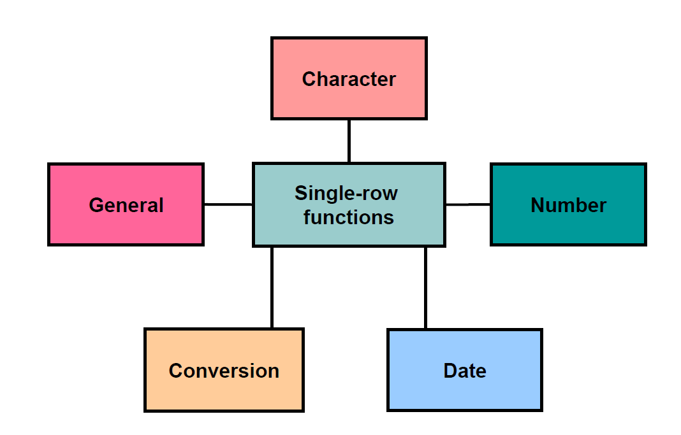
SINGLE ROW FUNCTIONS
Macam-macam single row function:

Slide 8
SINGLE ROW FUNCTIONS CHARACTER FUNCTIONS
Membutuhkan input berupa data karakter.
Case Convertion
LOWER (column|expression) Converts character values to lowercase
UPPER (column|expression) Converts character values to uppercase
Char Manipulation
SUBSTR (column|expression,m[,n]) Returns specified characters from character value starting at character position m, n characters long
CONCAT (column1|expression1, column2|expression2) Concatenates the first character value to the second character value;
TRIM (column/expression) Enables you to trim leading or trailing characters
REPLACE (text, search_string, replacement_string) Searches a text expression for a character string and, if found, replaces it with a specified replacement string
dan sebagainya.

Slide 9
SINGLE ROW FUNCTIONS CHARACTER FUNCTIONS
INPUT
FUNCTION
OUTPUT
TABK | LOWER(INPUT) | tabk
Pusdiklat KU | UPPER(INPUT) | PUSDIKLAT KU
TABK Pusdiklat KU | CONCAT(a, ‘ ‘, b) | TABK Pusdiklat KU
Pusdiklat KU | SUBSTRING(1, 3) | Pus
SQL | LEN(INPUT) | 3
‘1234567 ‘ | TRIM(INPUT) | ‘1234567’
TABK ACL | REPLACE(INPUT, ‘ACL’, ‘SQL’) | TABK SQL
dan sebagainya.

Slide 10
SINGLE ROW FUNCTIONS NUMBER & DATE
Membutuhkan input berupa data numeric dan date/datetime
NUMERIC
ROUND(column|expression, n, m) | Rounds the column, expression, or value to n decimal, m <> 0 truncate, m= 0 default
ABS(column|expression) | Returns the absolute value of a number.
DATE
GETDATE() | Return the sysdate
DATEDIFF(interval, date1, date2) | Returns the difference between two dates.
DATEADD(interval, number, date) | Adds a time/date interval to a date and then returns the date.
DATENAME(interval, date) | Returns a specified part of a date.

Slide 11
SINGLE ROW FUNCTIONS DATE FUNCTIONS
DATE
DAY(date) | Returns the day of the month (from 1 to 31) for a specified date. Output is numeric
MONTH(date) | Returns the month of the year(from 1 to 12) for a specified date. Output is numeric
YEAR(date) | Returns the year for a specified date. Output is numeric
dan sebagainya.

Slide 12
SINGLE ROW FUNCTIONS NUMBER & DATE
INPUT
FUNCTION
OUTPUT
0.02 | ROUND(INPUT, 1) | 0.00
0.567 | ROUND(INPUT, 2) | 0.570
-100 | ABS(INPUT) | 100
 | GETDATE() | ‘2021-06-07 08:00:00.260’
‘2021-06-07’ ‘2021-06-13’ | DATEDIFF(day, a, b) | 6
 | DATEDIFF(day, b, a) | -6
 | DATEDIFF(year , a, b) | 0
 | DATEADD(day , 6 , a) | ‘2021-06-13’
 | DAY(a) | 7
 | MONTH(b) | 6
 | YEAR(b) | 2021
 | DATENAME(month, a) | June

Slide 13
SINGLE ROW FUNCTIONS CONVERSION & GENERAL
GENERAL
ISNULL(expression, value) | Returns a specified value if the expression is NULL.
CAST(expression AS datatype(length)) | converts a value (of any type) into a specified datatype.
INPUT
FUNCTION
OUTPUT
NULL | ISNULL(INPUT, 0) | 0
NULL | ISNULL(INPUT, ‘KOSONG’) | KOSONG
123 | CAST(INPUT AS VARCHAR) | ‘123’
‘0123’ | CAST(INPUT AS INT) | 123

Slide 14
GROUP FUNCTION

Slide 15
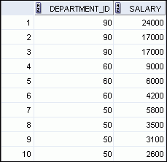


What Are Group Functions?
Group functions operate on sets of rows to give one result per group.
EMPLOYEES
Maximum salary in EMPLOYEES table
…
Notes:
What Are Group Functions?
Unlike single-row functions, group functions operate on sets of rows to give one result per group. These sets may comprise the entire table or the table split into groups.

Slide 16
Group Functions: Syntax
SELECT group_function(column), ...
FROM table
[WHERE condition]
[ORDER BY column];
Notes:
Group Functions: Syntax
The group function is placed after the SELECT keyword. You may have multiple group functions separated by commas.
Guidelines for using the group functions:
DISTINCT makes the function consider only nonduplicate values; ALL makes it consider every value, including duplicates. The default is ALL and therefore does not need to be specified.
The data types for the functions with an expr argument may be CHAR, VARCHAR2, NUMBER, or DATE.
All group functions ignore null values. To substitute a value for null values, use the NVL, NVL2, or COALESCE functions.

Slide 17
Types of Group Functions
AVG
COUNT
MAX
MIN
SUM
STDDEV
VARIANCE
Group
functions
Notes:
Types of Group Functions
Each of the functions accepts an argument. The following table identifies the options that you can use in the syntax:

Slide 18

AVG and SUM
You can use AVG and SUM for numeric data.
SELECT AVG(salary), MAX(salary),
MIN(salary), SUM(salary)
FROM employees
WHERE job_id LIKE '%REP%';
Notes:
Using the AVG and SUM Functions
You can use the AVG, SUM, MIN, and MAX functions against the columns that can store numeric data. The example in the slide displays the average, highest, lowest, and sum of monthly salaries for all sales representatives.

Slide 19

MIN and MAX
You can use MIN and MAX for numeric, character, and date data types.
SELECT MIN(hire_date), MAX(hire_date)
FROM employees;
Notes:
Using the MIN and MAX Functions
You can use the MAX and MIN functions for numeric, character, and date data types. The example in the slide displays the most junior and most senior employees.
The following example displays the employee last name that is first and the employee last name that is last in an alphabetic list of all employees:
SELECT MIN(last_name), MAX(last_name)
FROM employees;
Note: The AVG, SUM, VARIANCE, and STDDEV functions can be used only with numeric data types. MAX and MIN cannot be used with LOB or LONG data types.

Slide 20


COUNT Function
COUNT(*) returns the number of rows in a table:
COUNT(expr) returns the number of rows with non-null values for expr:
SELECT COUNT(*)
FROM employees
WHERE department_id = 50;
1
SELECT COUNT(commission_pct)
FROM employees
WHERE department_id = 80;
2
Notes:
Using the COUNT Function
The COUNT function has three formats:
COUNT(*)
COUNT(expr)
COUNT(DISTINCT expr)
COUNT(*) returns the number of rows in a table that satisfy the criteria of the SELECT statement, including duplicate rows and rows containing null values in any of the columns. If a WHERE clause is included in the SELECT statement, COUNT(*) returns the number of rows that satisfy the condition in the WHERE clause.
In contrast, COUNT(expr) returns the number of non-null values that are in the column identified by expr.
COUNT(DISTINCT expr) returns the number of unique, non-null values that are in the column identified by expr.
Examples:
1. The example in the slide displays the number of employees in department 50.
2. The example in the slide displays the number of employees in department 80 who can earn a commission.

Slide 21

DISTINCT IN GROUP
COUNT(DISTINCT expr) returns the number of distinct non-null values of expr.
To display the number of distinct department values in the EMPLOYEES table:
SELECT COUNT(DISTINCT department_id)
FROM employees;
Notes:
Using the DISTINCT Keyword
Use the DISTINCT keyword to suppress the counting of any duplicate values in a column.
The example in the slide displays the number of distinct department values that are in the EMPLOYEES table.

Slide 22

Group Functions and Null Values
Group functions ignore null values in the column:
SELECT AVG(commission_pct)
FROM employees;
1
Notes:
Group Functions and Null Values
All group functions ignore null values in the column.
However, the NVL function forces group functions to include null values.
Examples:
1. The average is calculated based on only those rows in the table in which a valid value is stored in the COMMISSION_PCT column. The average is calculated as the total commission that is paid to all employees divided by the number of employees receiving a commission (four).
2. The average is calculated based on all rows in the table, regardless of whether null values are stored in the COMMISSION_PCT column. The average is calculated as the total commission that is paid to all employees divided by the total number of employees in the company (20).

Slide 23
GROUP FUNCTION
Bekerja pada SET/BEBERAPA ROW dan memberikan suatu hasil pada setiap grup.
Dapat dijalankan dengan/tanpa clause GROUP BY
MIN(n) | Minimum value of n, ignoring null values
MAX(n) | Maximum value of n, ignoring null values
AVG(n) | Average value of n, ignoring null values
COUNT(n) | Number of rows, where n evaluates to something other than null (count all selected rows using *, including duplicates and rows with nulls)
SUM(n) | Sum values of n, ignoring null values
STDEV(n) | Standard deviation of n, ignoring null values

Slide 24


Illegal Queries Using Group Functions
Any column or expression in the SELECT list that is not an aggregate function must be in the GROUP BY clause:
SELECT department_id, COUNT(last_name)
FROM employees;
A GROUP BY clause must be added to count the last names for each department_id.
SELECT department_id, job_id, COUNT(last_name)
FROM employees
GROUP BY department_id;
Either add job_id in the GROUP BY or remove the job_id column from the SELECT list.
Notes:
Illegal Queries Using Group Functions
Whenever you use a mixture of individual items (DEPARTMENT_ID) and group functions (COUNT) in the same SELECT statement, you must include a GROUP BY clause that specifies the individual items (in this case, DEPARTMENT_ID). If the GROUP BY clause is missing, then the error message “not a single-group group function” appears and an asterisk (*) points to the offending column. You can correct the error in the first example in the slide by adding the GROUP BY clause:
SELECT department_id, count(last_name)
FROM employees
GROUP BY department_id;
Any column or expression in the SELECT list that is not an aggregate function must be in the GROUP BY clause. In the second example in the slide, job_id is neither in the GROUP BY clause nor is it being used by a group function, so there is a “not a GROUP BY expression” error. You can correct the error in the second slide example by adding job_id in the GROUP BY clause.
SELECT department_id, job_id, COUNT(last_name)
FROM employees
GROUP BY department_id, job_id;

Slide 25
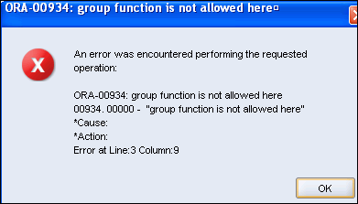
Illegal Queries Using Group Functions
You cannot use the WHERE clause to restrict groups.
You use the HAVING clause to restrict groups.
You cannot use group functions in the WHERE clause.
SELECT department_id, AVG(salary)
FROM employees
WHERE AVG(salary) > 8000
GROUP BY department_id;
Cannot use the WHERE clause to restrict groups
Notes:
Illegal Queries Using Group Functions (continued)
The WHERE clause cannot be used to restrict groups. The SELECT statement in the example in the slide results in an error because it uses the WHERE clause to restrict the display of the average salaries of those departments that have an average salary greater than $8,000.
However, you can correct the error in the example by using the HAVING clause to restrict groups:
SELECT department_id, AVG(salary)
FROM employees
GROUP BY department_id
HAVING AVG(salary) > 8000;

Slide 26
CASE WHEN

Slide 27
SQL CASE Statement
Perintah CASE sering digunakan untuk menampilkan nilai tertentu dari beberapa barisan data dengan syarat-syarat atau kondisi yang kita berikan.
Contoh:
SELECT nama, CASE alamat
WHEN 'PMK' THEN 'PAMEKASAN'
WHEN 'SMP' THEN 'SAMPANG'
ELSE alamat END AS kota_lahir
FROM table_kota
SELECT FIRST_NAME,
CASE
WHEN SALARY >6000 THEN 'High'
ELSE 'Low'
END as category
FROM EMPLOYEES

